Slide 1

SMART ATTENDANCE THROUGH FACE RECOGNITION
Bhavana Pasula
Vasavi Lankipalle
Soujanya Mumbala
Vaishali Tappeta Venkataramana

Slide 2

INTRODUCTION
Nowadays Attendance is considered as an important factor for both the student as well as the teacher of an educational organization. With the advancement of the deep learning technology the machine automatically detects the attendance performance of the students and maintains a record of those collected data. In general, the attendance system of the student can be maintained in two different forms namely,
1. Manual Attendance System (MAS)
2. Automated Attendance System (AAS).

Slide 3
1. MANUAL ATTENDANCE SYSTEM
Manual Student Attendance Management system is a process where a teacher concerned with the subject need to call the students name and mark the attendance manually. Manual attendance may be considered as a time-consuming process or sometimes it happens for the teacher to miss someone, or students may answer multiple times on the absence of their friends.
So, the problem arises when we think about the traditional process of taking attendance in the classroom. To solve all these issues, we go with Automatic Attendance System(AAS).

Slide 4
2. AUTOMATIC ATTENDANCE SYSTEM
Feature-based approach
Brightness based approach
The Feature-based approach also known as local face recognition system, used in pointing the key features of the face like eyes, ears, nose, mouth, edges, etc.,

Slide 5
EXISTING RECOGNITION SYSTEMS
Fingerprint Based recognition system
RFID (Radio Frequency Identification) Based recognition system
Iris Based Recognition System
Face Based Recognition System

Slide 6

PROPOSED SYSTEM
The task of the proposed system is to capture the face of each student and to store it in the database for their attendance. The face of the student needs to be captured in such a manner that all the feature of the students' face needs to be detected, even the seating and the posture of the student need to be recognized. There is no need for the teacher to manually take attendance in the class because the system records a video and through further processing steps the face is being recognized and the attendance database is updated.

Slide 7
WHAT EXACTLY IS FACIAL RECOGNITION ?
A facial recognition is a computer application for automatically identifying or verifying a person from a digital image or a video frame from a video source.
One of the ways to do this is by comparing selected facial features from the image and a facial database

Slide 8
HOW FACIAL RECOGNITION WORKS ?
You might be good at recognizing faces. You probably find it a cinch to identify the face of a family member, friend, or acquaintance. You’re familiar with their facial features — their eyes, nose, mouth — and how they come together.
That’s how a facial recognition system works, but on a grand, algorithmic scale. Where you see a face, recognition technology sees data. That data can be stored and accessed.

Slide 9
Algorithm Used
Local Binary Pattern (LBP) is a simple yet very efficient texture operator which labels the pixels of an image by thresholding the neighborhood of each pixel and considers the result as a binary number.
It was first described in 1994 (LBP) and has since been found to be a powerful feature for texture classification. It has further been determined that when LBP is combined with histograms of oriented gradients (HOG) descriptor, it improves the detection performance considerably on some datasets.

Slide 10
STEPS INCLUDED
Training the Algorithm
Applying the LBPH operation
Extracting the Histograms
Performing the face recognition

Slide 11
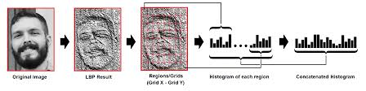
Extracting the Histograms :
Now, using the image generated in the last step, we can use the Grid X and Grid Y parameters to divide the image into multiple grids, as can be seen in the following image:

Slide 12
MODULES
Student Registration
Face Recognition
Capturing Video
Attendance Reports
Post Attendance

Slide 13
SYSTEM REQUIREMENTS
Software Requirements :
Operating System : Windows
Coding Language : Python
Front End : HTML, CSS
Back End : Mongo dB, LBPH algorithm, haar cascade
Hardware Requirements :
Webcam or Video Surveillance Camera
Laptop or Personal Computer

Slide 14
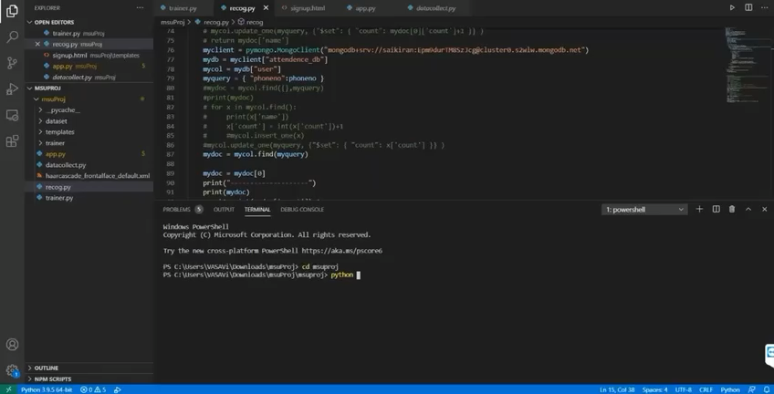
EXPERIMENT DEMO

Slide 15
CONCLUSION
From this project, It can be concluded that a reliable, secure, fast and an efficient system has been developed replacing a manual and unreliable system. This system can be implemented for better results regarding the management of attendance and leaves. The system will save time, reduce the amount of work the administration must do and will replace the stationery material with electronic apparatus and reduces the amount of human resource required for the purpose.

Slide 16

THANK YOU!

